Slide 1
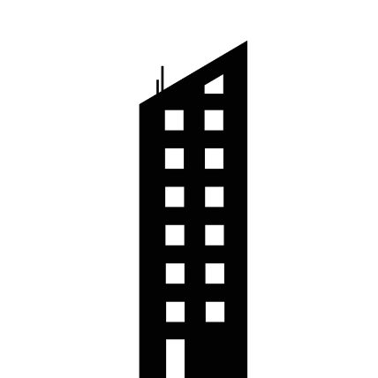


Fresnel Zone
Fresnel zones are concentric ellipses centered on the direct transmission path.
The zone surrounding the RF LoS is said to be the Fresnel zone
Line of Sight (LOS)
Fresnel Zone
Line of Sight

Slide 2
Fresnel Zone
Non Line of Sight (NLOS)
Fresnel Zone
Line of Sight
d1
d2
Fig: Fresnel Zone obstructed by Obstacle

Slide 3
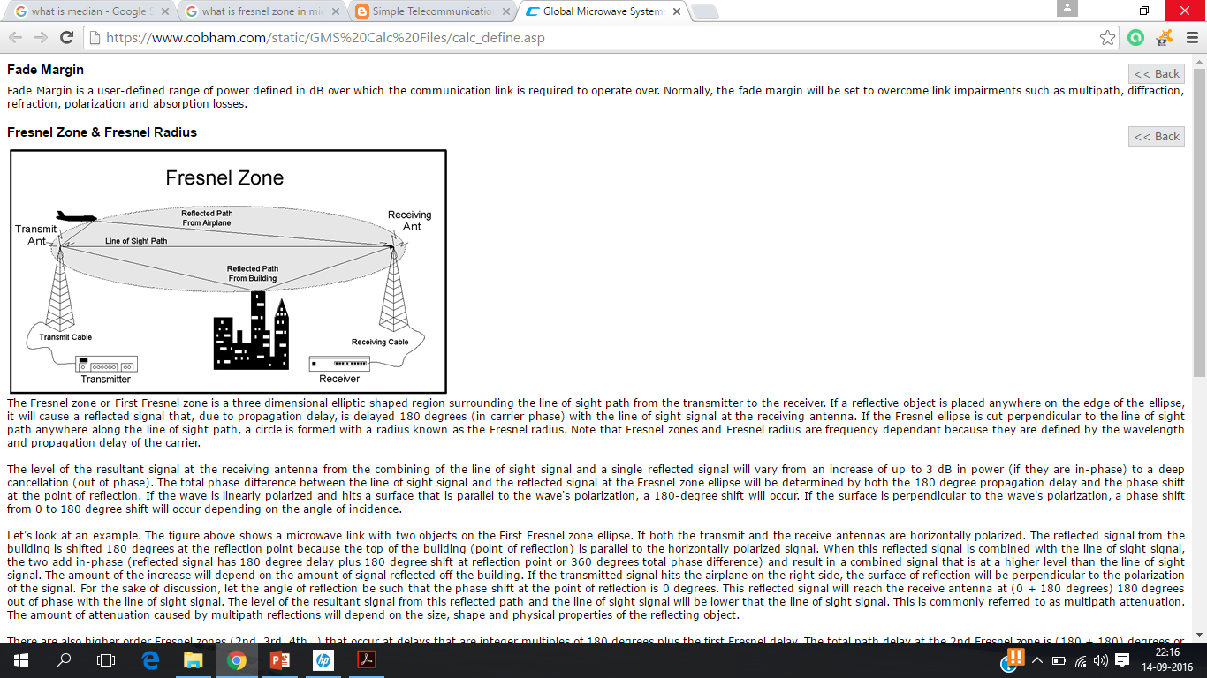
Fresnel Zone
The first Fresnel zone is the region where the transmission energy is the most intense.
The obstruction in the Fresnel zone should be as little as possible.
When planning a new link try to maintain good clearance between two stations, avoiding obstruct the first Fresnel zone.
At least 55% of the first Fresnel zone should be kept clear so that the loss is not much.

Slide 4

Fresnel Zone
The general equation for calculating the Fresnel zone radius at any point P in between the endpoints of the link
F_{n} = The nth Fresnel Zone radius in metres
d₁ = The distance of P from one end in metres
d₂ = The distance of P from the other end in metres
λ= The wavelength of the transmitted signal in metres.

Slide 5
Problems
Frequency of the transmitted signal =900Mhz
Distance from transmitter to point P= 1Km
Distance from receiver to Point P =2 Km
Radius of point P of 3rd Fresnel zone?
Solution:
= 1.5

Slide 6
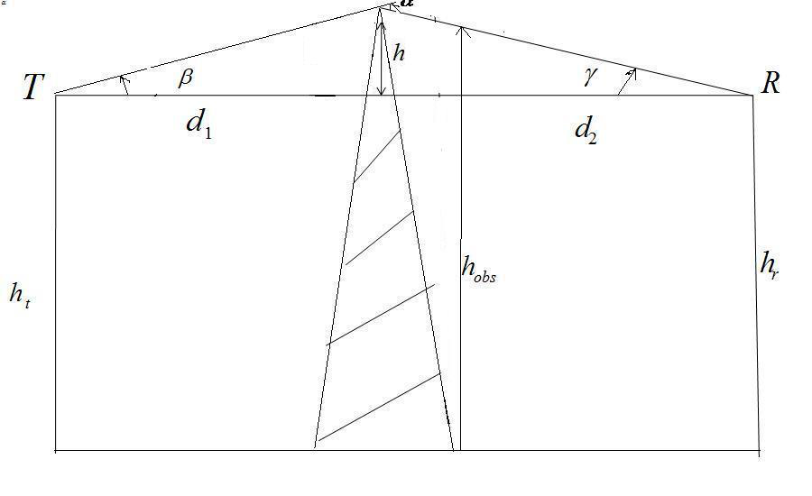
Knife Edge Diffraction Model
Estimating signal attenuation due to knife edge diffraction
Courtesy to Theodore S. Rappaport
©2002, 1996 Prentice Hall PTR

Slide 7
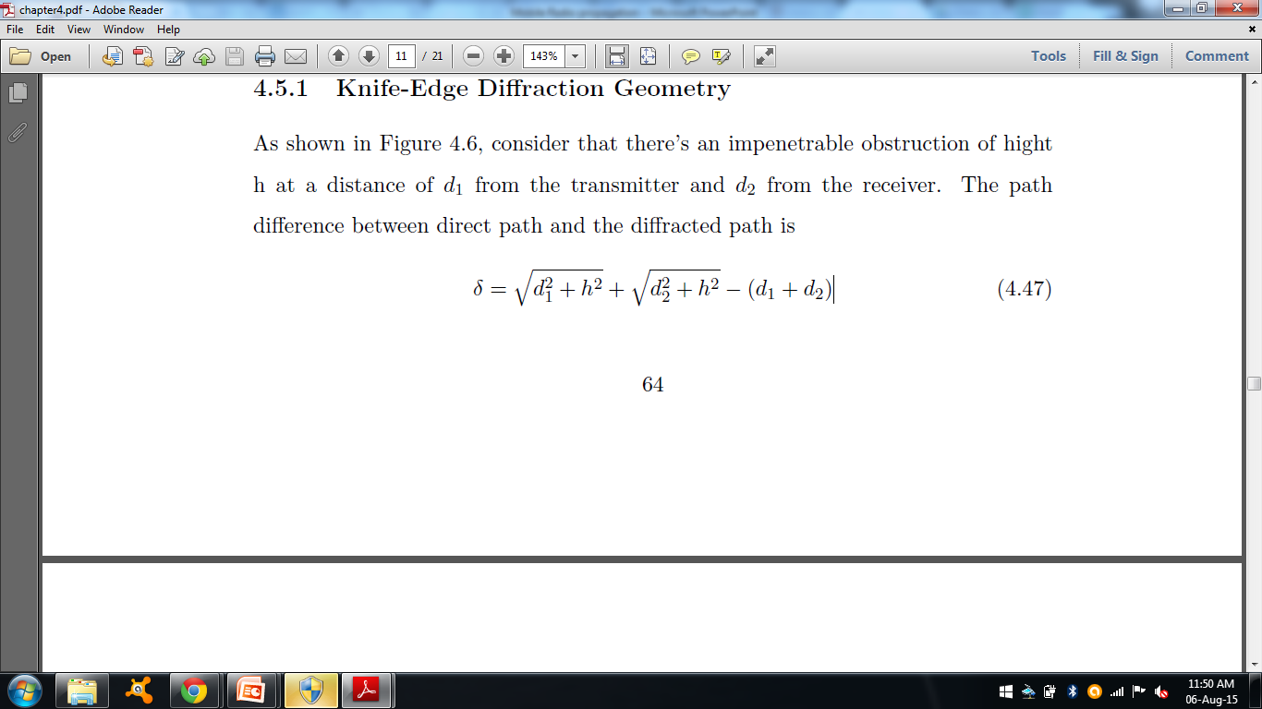
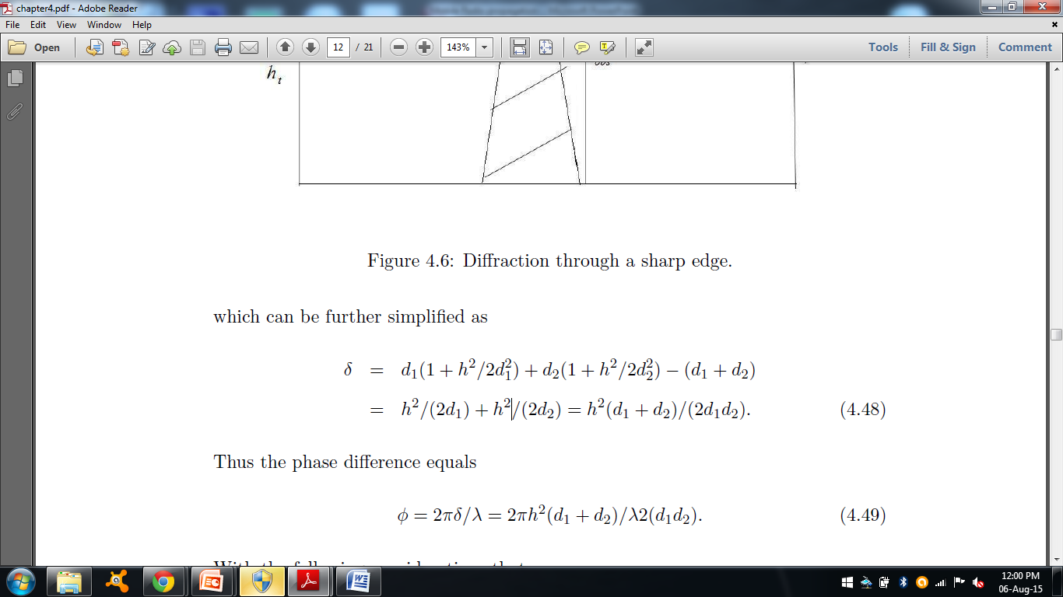
Knife Edge Diffraction Model
consider that there’s an obstruction of height h at a distance of d1 from the transmitter and d2 from the receiver. The path
Difference between direct path and the diffracted path is

Slide 8
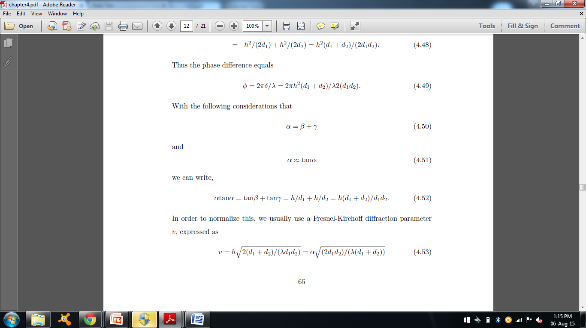
Knife Edge Diffraction Model
Tan α = tan β + tan γ
Tan α ≈ α
α = h/d1 + h/d2 = h(d1 + d2)/d1d2.
V is the fresnel diffraction parameter
φ= πv²/2

Slide 9
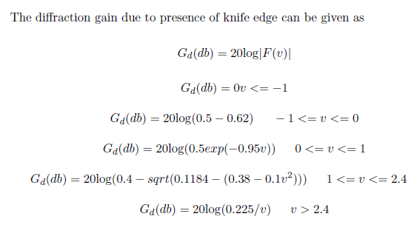
Knife Edge Diffraction Model
Courtesy to Theodore S. Rappaport
©2002, 1996 Prentice Hall PTR

Slide 10
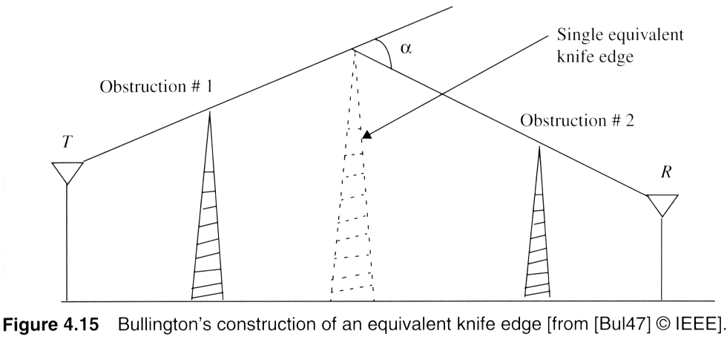
Multiple knife-edge diffraction
Multiple Knife-edge diffraction : For the presence of two knife edges, replace it by an equivalent knife edge.
Courtesy to Theodore S. Rappaport
©2002, 1996 Prentice Hall PTR

Slide 11
Example
Compute the diffraction parameter for h=25m. Assume wavelength as 1/3m, d1= 2 km, d2=2km. Identify the fresnel zone within which the tip of the obstruction lies.
Solution:
Δ=
Δ= nλ/2. Therefore n= 2 Δ / λ.

Slide 12
Problem
Frequency of signal =1000Mhz, ht = 50m, hr= 25m, Knife edge= 125 m
Distance from transmitter to obstacle= 15km, Distance from receiver to obstacle = 2Km
Loss due to diffraction parameter
Solution:
Find wavelength from frequency given.
Redraw the geometry.
Find β and γ values . α =β + γ in radians.
β = tan⁻¹((100-25)/15000)
γ= tan⁻¹ (75/2000)
h
T
25m
R

Slide 13
Problem
Use equation of V to find the diffraction parameter.
With the value of V, find the diffraction loss.

Slide 14
Summary
Fresnel zones are concentric ellipses centered on the direct transmission path.
Estimating the signal attenuation in case of knife edge diffraction.
In Hilly area, propagation path may have multiple obstacles. The total diffraction loss is due to all the obstacles. Bullington suggested a single equivalent obstacle to compute the same.

